Slide 1
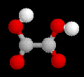
Organic Compounds
with Functional groups
Remember : Hydrocarbons (without functional groups) were covered in Year 11. If you go to the Year 11 page you will be able to use that PowerPoint for REVISION.

Slide 2
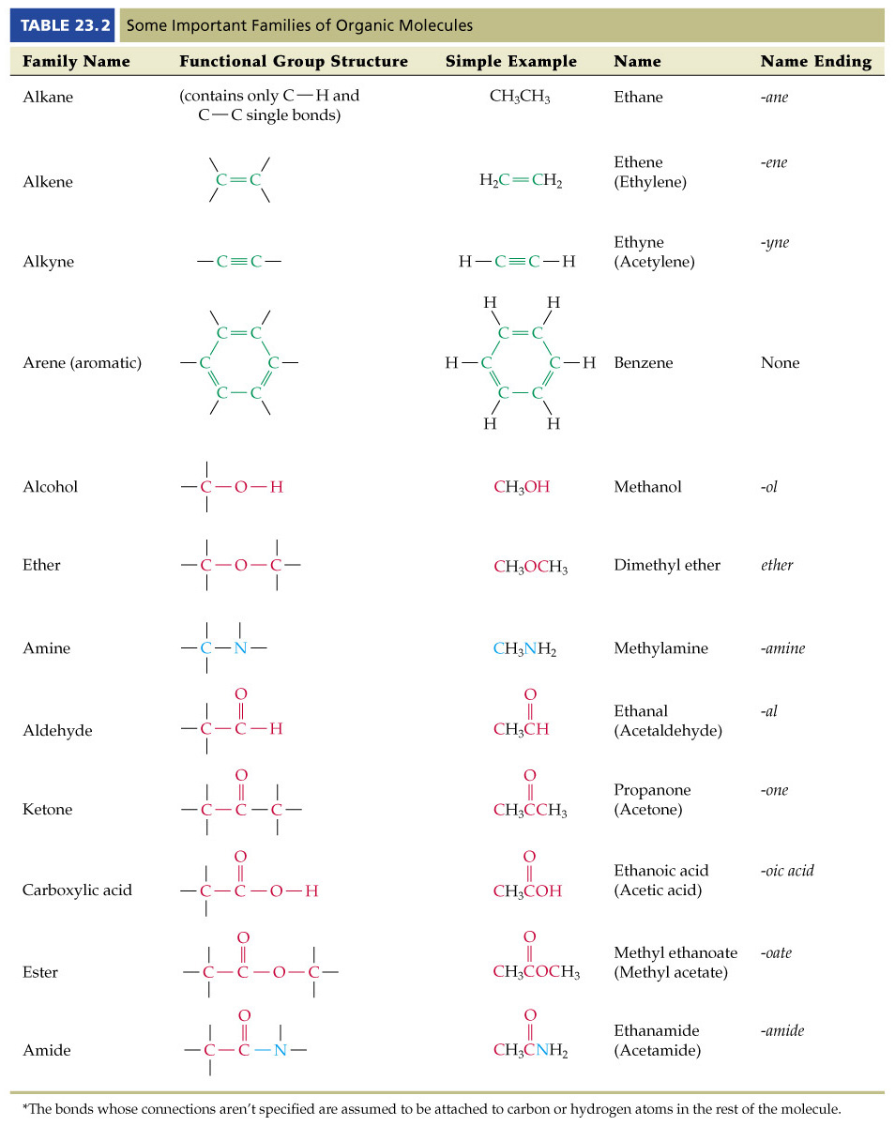

Slide 4
N.B. - To observe the molecules on the link below you will first need to download the CHIME software.
To get to a site where you can download CHIME for free click here.
http://people.ouc.bc.ca/woodcock/molecule/molecule.html
Link to shapes of various organic molecules

Slide 5
Haloalkanes
Atomic grouping
-F,-Cl,-Br or -I
Suffix
Prefix
fluoro, chloro, etc.
Position in chain
anywhere
General formula
R-X
Common family name

Slide 6




Examples of Haloalkanes
Compound
IUPAC Name
Molecular Model
CH₃F
Fluoromethane
pdb model
CH₂Cl₂
Dichloromethane
pdb model
CF₃CCl₂H
2,2-Dichloro-1,1,1-trifluoroethane
pdb model
1-bromo-1-chloro-1-propene
pdb model
1-bromo-2-methyl-2-butene
pdb model
2-Iodobutane
pdb model
Bromocyclohexane
pdb model

Slide 7
Preparation of Haloalkanes (Year 11 Revision)
Substitution : Halogenation of an alkane.
_{UV}
RH + X₂  RX + HX
_{UV}
Eg. CH₃CH₃ + Cl₂  CH₃CH₂Cl + HCl
ethane + chlorine ’ chloroethane + hydrogen chloride
Addition : Hydrohalogenation of an alkene.
_{UV}
RH + RX  RCHXCH₃
_{UV}
Eg. CH₃CH=CH₂ + HF  CH₃CHFCH₃
propene + hydrogen fluoride ’ 2-fluoropropane
Notice how Markovnikoff’s Rule has been applied.

Slide 8

Alcohols
Atomic grouping
Suffix
-ol
Prefix
hydroxy
Position in chain
anywhere
General formula
C_{n}H_{2n+2}O
Common family name
alcohols

Slide 9









Structure
IUPAC Name
Model
methanol
pdb model
ethanol
pdb model
Examples
Of
Alcohols
1-propanol
pdb model
2-propanol
pdb model
cyclopentanol
pdb model
1,2-ethanediol
pdb model
4-penten-2-ol
pdb model
3-pentyn-1-ol
pdb model
4-aminobutan-1-ol
pdb model

Slide 10
Preparation of Alcohols (Year 11 Revision)
Hydration of an alkene (in presence of an acid).
_{H}+
RCH=CH₂ + H₂O  RCHOHCH₃
_{H}+
Eg. CH₃CH =CH₂ + H₂O  CH₃CHOHCH₃
propene + water ’ 2-propanol
Notice how Markovnikoff’s Rule has been applied once again.

Slide 11


A Types of Alcohols
Alcohols are classified by the carbon that they are bonded to.
A primary alcohol is attached to a primary carbon.
A secondary alcohol is attached to a secondary carbon.
A tertiary alcohol is attached to a tertiary carbon.
Primary Secondary Tertiary
alcohol alcohol alcohol

Slide 12

Reactions of Alcohols
Reaction with Sodium.
Alcohol + Sodium   Alkoxide + Hydrogen
2 ROH + 2 Na  2 RO⁻Na⁺ + H₂
Esterification
Alcohol + Carboxylic Acid  Ester + Water
R’OH + RCOOH  RCOOR’ + H₂O
+

Slide 13


Reactions of Alcohols – ctd.
Oxidation of alcohols with Oxidising Agent.
1° Alcohol + MnO₄⁻_{(aq)} + H⁺_{(aq)}  Aldehyde  Acid
RCH₂OH  RCHO  RCOOH
2° Alcohol + MnO₄⁻_{(aq)} + H⁺_{(aq)}  Ketone
RCHOHR’  RCOR’

Slide 14

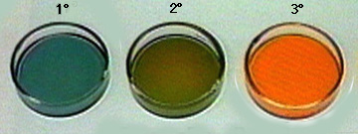
Reactions of Alcohols – ctd.
Oxidation of alcohols with Oxidising Agent.
3° Alcohol + MnO₄⁻_{(aq)} + H⁺_{(aq)}  No Reaction
Samples of alcohols are added to acidic dichromate solutions, which are orange. Primary alcohols react quickly to form aldehydes & then acids , secondary alcohols react at a moderate rate to form ketones and tertiary alcohols do not react.

Slide 15

Amines
Atomic grouping
Suffix
-amine
Prefix
amino
Position in chain
anywhere
General formula
C_{n}H_{2n+3}N
Amines can act as a base (proton acceptor) like ammonia
RNH₂ + H⁺_{(aq)}  RNH₃⁺_{(aq)}

Slide 16






Structure
IUPAC Name
Model
Examples
Of
Amines
methanamine
pdb model
ethanamine
pdb model
1-propanamine
pdb model
2-propanamine
pdb model
1,2-ethanediamine
pdb model
cyclopentanamine
pdb model

Slide 17

Aldehydes
Atomic grouping
Suffix
-al
Prefix
oxo
Position in chain
only at
end of chain
General formula
C_{n}H_{2n}O
Common family name
aldehyde

Slide 18









Structure
IUPAC Name
Model
methanal (aka formaldehyde)
pdb model
ethanal
pdb model
nonanal
pdb model
Examples
Of
Aldehydes
3-ethylpentanal
pdb model
2-bromohexanal
pdb model
pentanedial
pdb model
3-oxohexanal
pdb model
2-ethyl-3-hydroxybutanal
pdb model
(2E,4Z)-octa-2,4-dienal
pdb model

Slide 19

Preparation & Properties of Aldehydes
As seen earlier in the oxidation of alcohols, oxidation of a primary alcohol with an acidified oxidant such as permanganate or dichromate ion leads to the formation of an aldehyde.
1° Alcohol + MnO₄⁻_{(aq)} + H⁺_{(aq)}  Aldehyde ( Acid)
RCH₂OH  RCHO ( RCOOH)
The aldehyde itself is susceptible to oxidation and hence needs to be isolated shortly after formation as continued oxidation with an acidified oxidant such as permanganate or dichromate ion leads to the formation of a carboxylic acid.
Aldehyde  Acid
RCHO  RCOOH

Slide 20

Ketones
Atomic grouping
Suffix
-one
Prefix
oxo
Position in chain
anywhere except at
end of chain
General formula
C_{n}H_{2n}O
Common family name
ketone

Slide 21










Structure
IUPAC Name
Model
propanone (aka acetone)
pdb model
butanone
pdb model
Examples
Of
Ketones
2-pentanone
pdb model
3,5-dimethyl-4-heptanone
pdb model
cyclohexanone
pdb model
3,5-heptadione
pdb model
1-cyclo-1-hexylpentanone
pdb model
pdb model
bicyclo[2.2.1]heptan-2-one
4-ethyl-4-hydroxyhexan-2-one
pdb model
(E)-pent-3-en-2-one
pdb model

Slide 22
Preparation & Properties of Ketones
Preparation : Oxidation of secondary alcohols with Oxidising Agent.
As seen earlier in the oxidation of alcohols, oxidation of a secondary alcohol with an acidified oxidant such as permanganate or dichromate ion leads to the formation of a ketone.
2° Alcohol + MnO₄⁻_{(aq)} + H⁺_{(aq)}  Ketone
RCHOHR’  RCOR’
The physical properties of ketones are similar to aldehydes. Unlike aldehydes however, ketones are not oxidised by acidified oxidant such as permanganate or dichromate.

Slide 23

Carboxylic Acids
Atomic grouping
Suffix
-oic acid (two words)
Prefix
carboxy (includes the carbon)
Position in chain
only at
end of chain
General formula
C_{n}H_{2n}O₂
Common family name
carboxylic acids

Slide 24







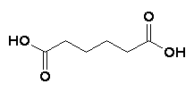

Structure
IUPAC Name
Model
methanoic acid
pdb model
Examples
Of
Carboxylic
Acids
ethanoic acid
(aka acetic acid)
pdb model
propanoic acid
pdb model
octanoic acid
pdb model
2-hexenoic acid
pdb model
6-methylheptanoic acid
pdb model
3-chloropentanoic acid
pdb model
hexanedioic acid
pdb model
6-hydroxy-4-oxononanoic acid
pdb model

Slide 25
Preparation of Carboxylic Acids
As seen earlier in the oxidation of alcohols, oxidation of a primary alcohol with an acidified oxidant such as permanganate or dichromate ion leads to the formation of an aldehyde. Further oxidation then leads to the formation of a carboxylic acid.
1° Alcohol + MnO₄⁻_{(aq)} + H⁺_{(aq)}  Aldehyde  Acid
RCH₂OH  RCHO  RCOOH
primary aldehyde carboxylic
alcohol acid

Slide 26
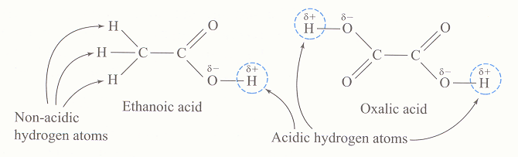
Properties of Carboxylic Acids – ctd.
Carboxylic acids are weak acids. Most molecules remain unionised when dissolved in water.
RCOOH  RCOO⁻ + H⁺
Only the hydrogen of the hydroxy group is an acidic hydrogens.
Properties of Carboxylic Acids
1. Reaction with reactive metals. Eg. Mg
magnesium + ethanoic acid  magnesium ethanoate + hydrogen.
Mg_{(s)} + 2CH₃CO₂H_{(aq)}  (CH₃CO₂)₂Mg_{(aq)} + H_{2(g)}

Slide 27
Properties of Carboxylic Acids - ctd
2. Reaction with alkalis. Acid + Base  Salt + Water
CH₃CO₂H_{(aq)} + KOH_{(aq)}  CH₃CO₂K_{(aq)} + H₂O_{(l)}
ethanoic acid + potassium  potassium + water.
hydroxide ethanoate
3. Reaction with carbonates.
Acid + Base  Salt + Water + CO₂
2CH₃CO₂H_{(aq)} + Na₂CO_{3(s)}  2CH₃CO₂Na_{(aq)} + CO_{2(g)} + H₂O_{(l)} ethanoic acid + sodium  sodium + carbon + water carbonate carbonate ethanoate dioxide
4. Esterification (see next section on Esters for more detail)
Alcohol + Carboxylic Acid  Ester + Water

Slide 28
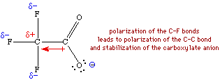
Strengths of Carboxylic Acids
As mentioned earlier carboxylic acids are weak acids. The strength of these acids can be increased by substituting hydrogen atoms for those of highly electronegative atoms eg. F, Cl. The high electron attracting ability of these atoms weakens the oxygen-hydrogen bond of the –OH group.

Slide 29
Strengths of Carboxylic Acids - ctd.
Increasing the number of halogen atoms will spread the charge out that must more and increase the acid strength of the acid. As the next table shows, the more chlorines you can attach the better:
ACID Ka
CH₃COOH 0.0000174
CH₂ClCOOH 0.00138
CHCl₂COOH 0.0513
CCl₃COOH 0.224

Slide 30

Esters
Atomic grouping
Suffix
-oate
Prefix
-
Position in chain
only at
end of chain
General formula
C_{n}H_{2n}O₂
Common family name
ester

Slide 31









Examples Of Esters
Structure
IUPAC Name
Model
methyl methanoate
pdb model
ethyl methanoate
pdb model
methyl ethanoate
pdb model
methyl propanoate
pdb model
ethyl hexanoate
pdb model
cyclohexyl ethanoate
pdb model
but-2-yl 3-methylpentanoate
pdb model
2,4-dimethylpent-3-yl 3-methylbutanoate
pdb model
diethyl pentanedioate
pdb model

Slide 32
Preparation of Esters - Esterification
Alcohol + Carboxylic Acid  Ester + Water
R’OH + RCOOH  RCOOR’ + H₂O
+

Slide 33



Properties of Esters
Esters tend to be liquids but the very large molecules can be solids. Solid animal fats and animal and vegetable oils are natural esters.
They are generally formed from
1,2,3-propanetriol (or glycerol) and
saturated & unsaturated fatty acids.
Glycerol
Oleic acid
The esters formed from glycerol and fatty acids are known as triglycerides
Triglyceride typical
of olive oil.

Slide 34
Still working on this section and beyond
http://people.ouc.bc.ca/woodcock/nomenclature/index.htm
Site for info on this slide

Slide 35
End of Slide Show
To Return to Year 12 Tutorial List
Choose Back from Menu above

